Slide 1
Speech Factorization: Squeeze Stereo Information from Speech Signals
Dong Wang, Tsinghua University
APSIPA 2019 Winter School
2019/11/16

Slide 2
Complex speech signal
Linguistic content
Speaker
Style
Noise
Channel
Emotion
Rich information blended in speech
Unknown independent components
Unknown convolution

Slide 3
Factorize speech signals
Factorize speech signals into simple factors are highly deriable
However it is an ill-posed problem!
Factors are not clear
Factor dependence are not clear

Slide 4
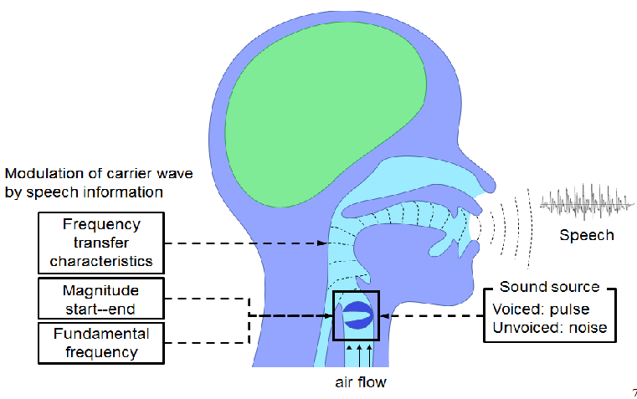
Factorization by physical assumptions
Impose ASSUMPTIONS of speech production process
ASSUMPTION 0: Speech is produced by a source- filter process.
ASSUMPTION 1: Source is either white noise or pulse train.
ASSUMPTION 2: Filter is an all-pole model, or linear prediction.
HTS document: http://hts.sp.nitech.ac.jp/

Slide 5
Factorize speech into source + filter
Source
Filter
Pulse train
Excitation
Linear
time-invariant
system
Speech
White noise

Slide 6
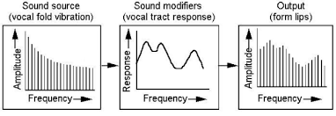
A deeper view in frequency domain
http://147.162.36.50/cochlea/cochleapages/theory/sndproc/sndcomm.htm

Slide 7
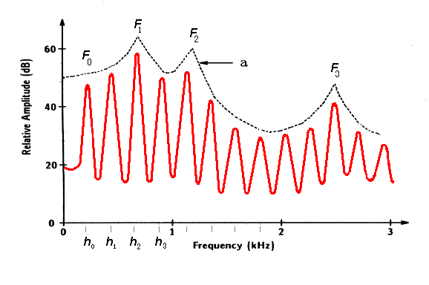
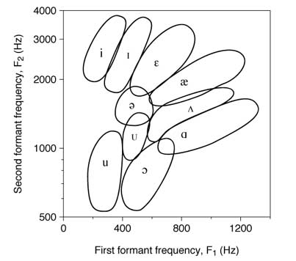
F0, harmonics, and formants
This figure illustrates the spectral structure of the harmonics under the formant profile of vowel a. In the course of a speech utterance, these profiles undergo abrupt changes that can perceived by the auditory apparatus only if appropriately filtered.
http://147.162.36.50/cochlea/cochleapages/theory/sndproc/sndcomm.htm

Slide 8
A very nice factorization
Physical and physiological rationality
Related to perceptual properties, e.g., pitch, linguistic content
Easy to manipulate
Easy to compute (LPC)

Slide 9
But it is not perfect
It is not task-oriented
Which is related to speaker traits?
Which is related to emotion?
It is not always stable
Difficulties in F0 estimation
Unexpected results after re-synthesis
It is not accurate
Temporal dependency not considered
Linear assumption is strong

Slide 10
We are seeking new factorization approaches
Ideally flexible enough
Ideally task-oritented
Ideally temporal dependent
Ideally complete
Ideally discriminative
…

Slide 11
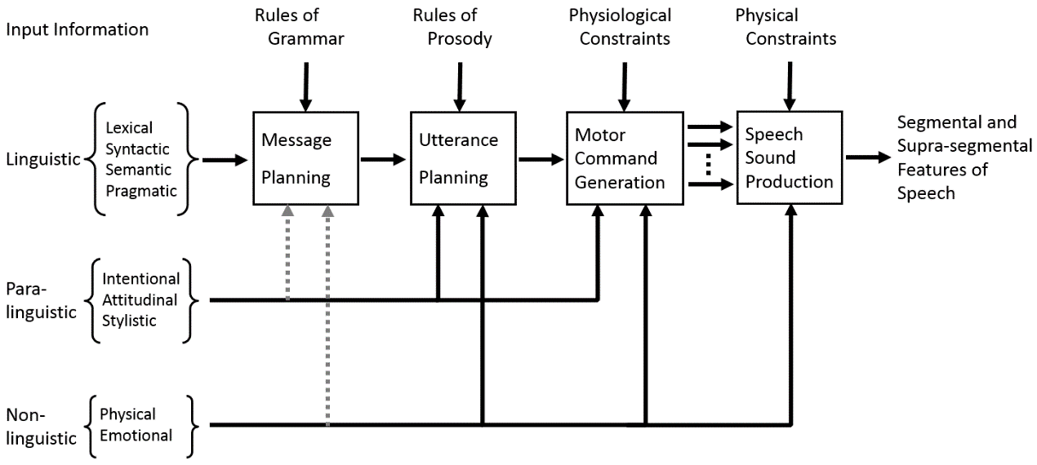
Fujisaki Model: A possible theoretical framework 20 years ago
Fujisaki H. Prosody, models, and spontaneous speech [M]//Computing prosody. Springer, New York, NY, 1997: 27-42.

Slide 12
Unfortunately, it is only conceptual
We don’t know the convolution nature, so cannot establish the generative model
We don’t know the inference method
We don’t know if it is true
In summary, we cannot convert it to a computational model

Slide 14
Two new observations made us happy
Short-time speaker recognition
Neural vocoder

Slide 15
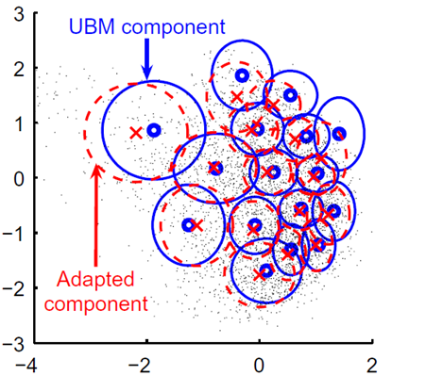
Puzzle on speaker traits
A long-term question: is speaker trait a long-term property?
If Yes, then we have no hope to factorize speech in short time, as speaker traits are important.
If No, then good….
Unfortunately, the 30 years of speaker recognition research seems give an answer ‘Yes’.

Slide 17
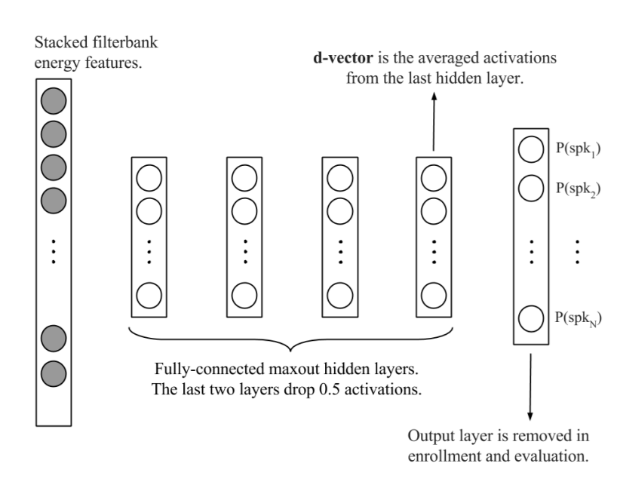
Success on shor-time speaker feature learning
Learn speaker-dependent features driven by speaker discrimination
Frame-based representation, average-based back-end
E. Variani, X. Lei, E. McDermott, I. L. Moreno, and J. Gonzalez- Dominguez, “Deep neural networks for small footprint text-dependent speaker verification,” ICASSP 2014.

Slide 18
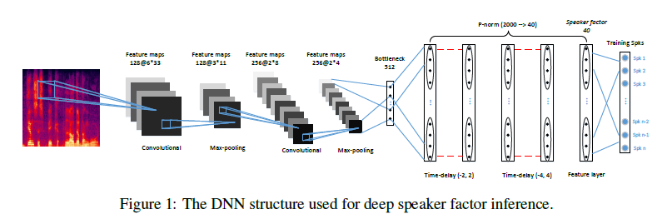
Success on shor-time speaker feature learning
L.L et al, Deep Speaker Feature Learning for Text-independent Speaker Verification, Interspeech 2017.

Slide 19
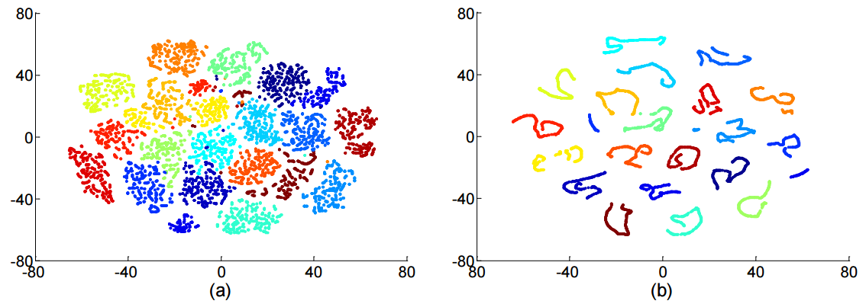
Success on shor-time speaker feature learning
L.L et al, Deep Speaker Feature Learning for Text-independent Speaker Verification, Interspeech 2017.

Slide 20
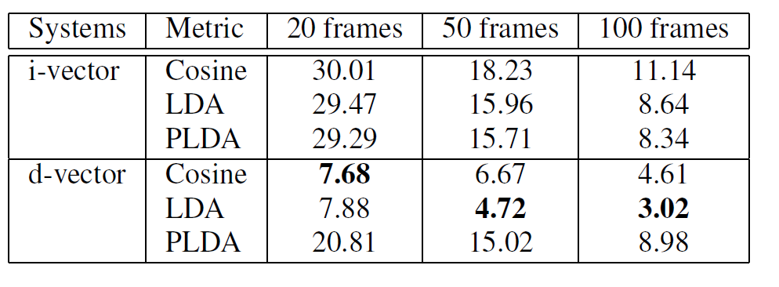
L.L et al, Deep Speaker Feature Learning for Text-independent Speaker Verification, Interspeech 2017.

Slide 21
Speaker characteristics are largely short-time patterns!

Slide 22
Puzzle on speech synthesis
We always needed a vocoder that uses both source and filter
It is a complete info approach, to derive both phase and magnitude
http://147.162.36.50/cochlea/cochleapages/theory/sndproc/sndcomm.htm

Slide 23
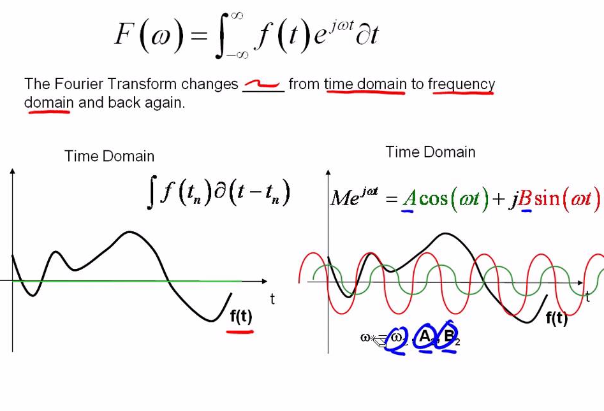
Can we just use the magnitude?
Seems not easy, as we need both phase and magnitude.
https://www.google.com/url?sa=i&source=images&cd=&ved=2ahUKEwijyeX4-O7lAhUMZt4KHQUNBNAQjRx6BAgBEAQ&url=https%3A%2F%2Fwww.youtube.com%2Fwatch%3Fv%3DObklYbQaX24&psig=AOvVaw3AZefJUFh4Kd4JOTL05HaP&ust=1574000933521714

Slide 24
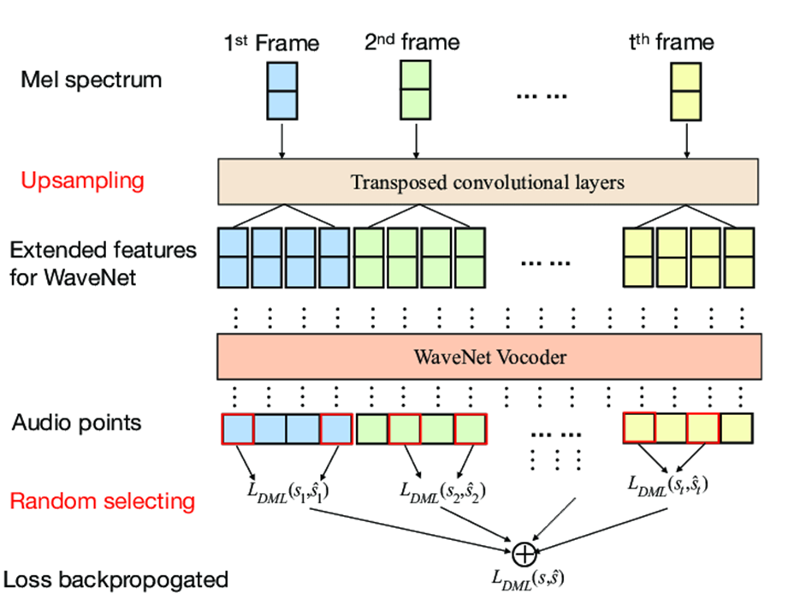
Neural vocoder eliminates phase!
WaveNet accept magnitude spectrum/ceptrum, and produce very nature speech
It means that mangnitude spectrum provides sufficient information for speech!
Yi Zhao et al., “Wasserstein GAN and Waveform Loss-based Acoustic Model Training for Multi-speaker Text-to-Speech Synthesis Systems Using a WaveNet Vocoder”

Slide 25
Seems we don’t need bother much on phase!

Slide 26
Now we have more confidence on Fujisaki model!
Short-time speaker recognition
We can focus on short-term factorization
Neural vocoder
We can focus on magnitude spectrum
But how to define the convolution?
We don’t assume the exact convolution form, by learn it from data using DNN
We only assume the convolution order

Slide 27
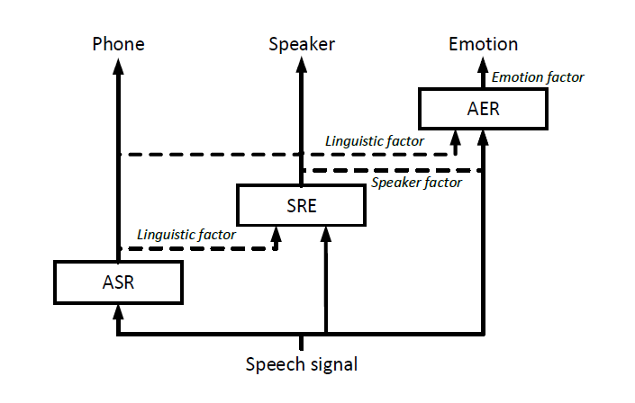
Deep cascaded factorization
Key feature:
Using task-oriented model to infer factors sequentially
Significant factors are inferred first
Purely discriminative
Lantian Li, Dong Wang, Yixiang Chen, Ying Shi, Zhiyuan Tang, "DEEP FACTORIZATION FOR SPEECH SIGNAL", ICASSP 2018

Slide 28
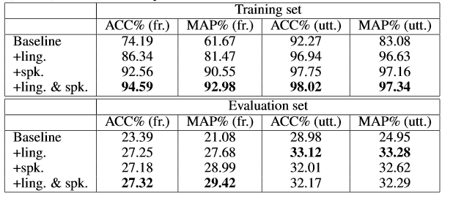
Application to emotion recognition

Slide 29
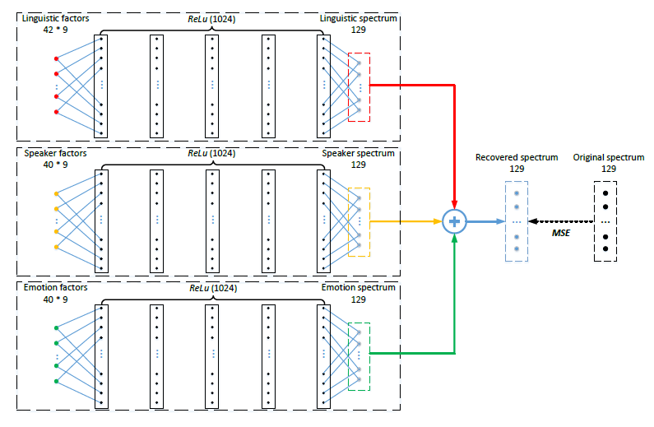
Completeness

Slide 30
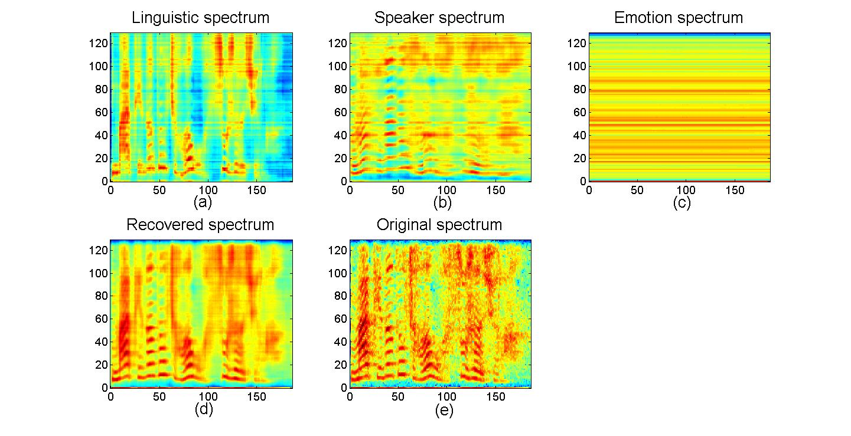

Slide 31
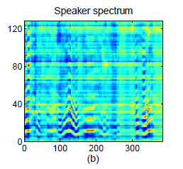
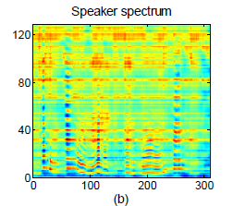
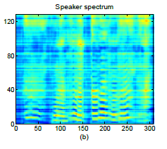
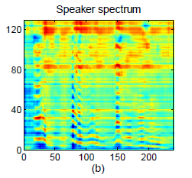
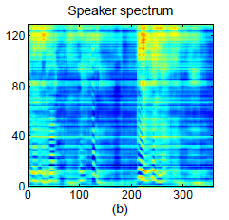
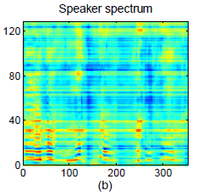
Voiceprint!

Slide 32
An inference model of Fujisaki model

Slide 33
Prons and Cons
Prons
It derives task-oriented factors, hence directly benefit for speech processing tasks
It fully uses data with different labels, hence sharing information
It is mostly useful for non-significant factors
Cons
It is purely discriminative, not directly related to the generation process
It is short-term, not temporally dependent

Slide 34
Can we design a generative Fujisaki model?
Simulate the generative process
Still can infer the factors
Ideally temporally dependent

Slide 35
Let’s think of an entropy presevation process
Each factor is an uncertainty, and contributes an additional entropy
All the entropy leads to variance of the speech signals
H(z-linguistic)
H(z-speaker)
H(x)
H(z-emotion)

Slide 36
Implemented as an invertible transform

Slide 37
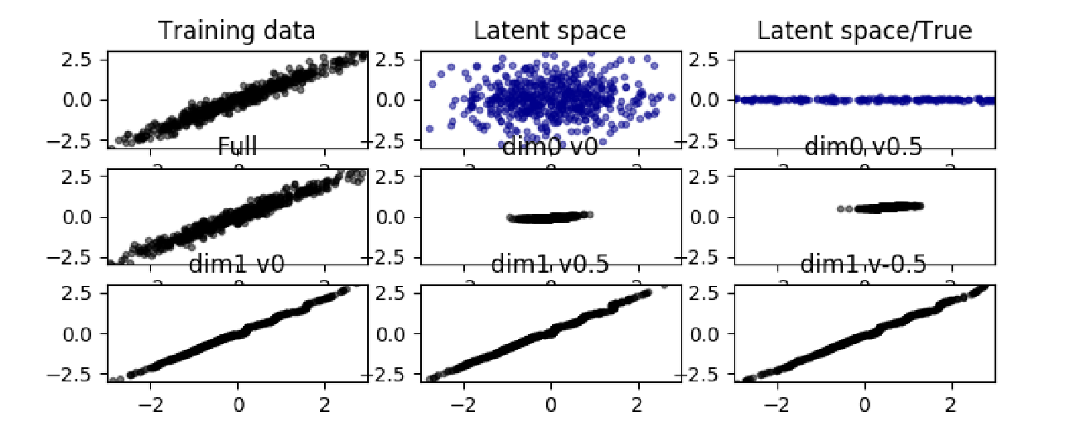
More assumptions
The factors are Gaussian and additive
The Jacobin and so the determinant are easy to compute
A simple example

Slide 38
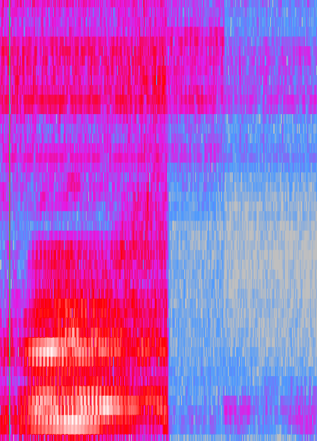
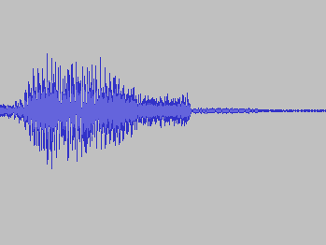
Apply to speech generation
Select single phones from TIMIT
Treat each segment as a picture
Silence padding

Slide 39
Apply to speech generation
Convert speech signals to a Gaussian ball…

Slide 40
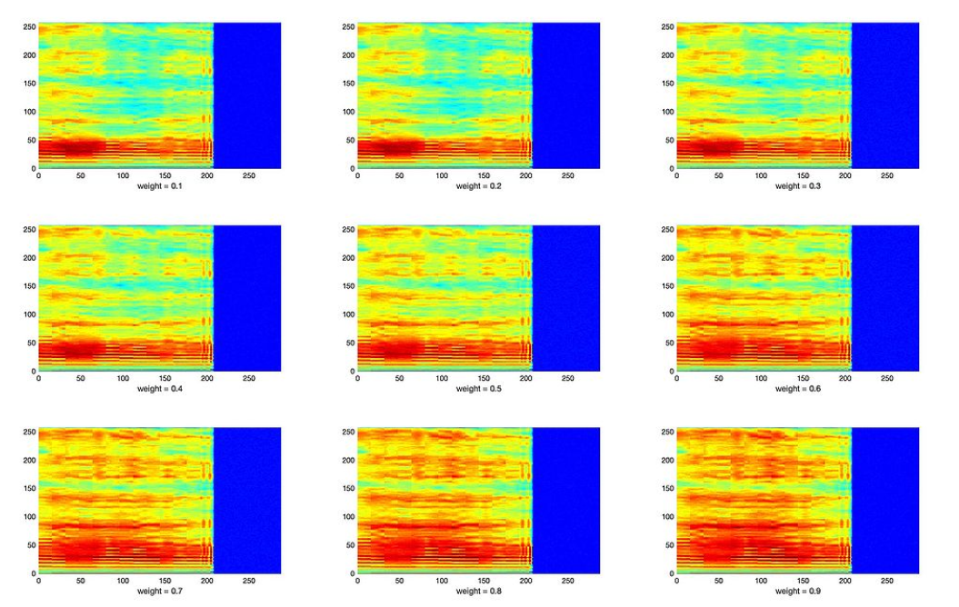
Walk in the z space

Slide 41
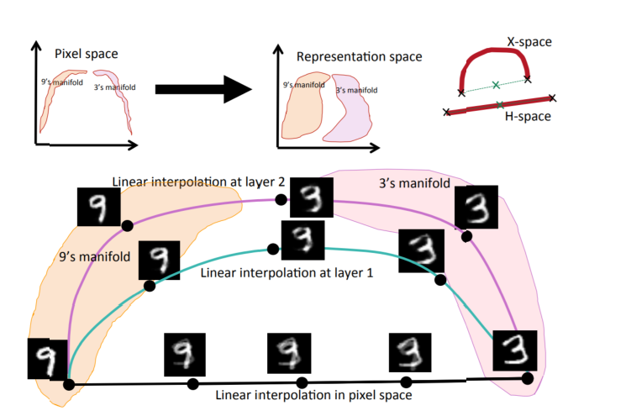
Sherjil Ozaira and Yoshua Bengio , Deep Directed Generative Autoencoders, 2014

Slide 42
Factorization by walking in the z space

Slide 43
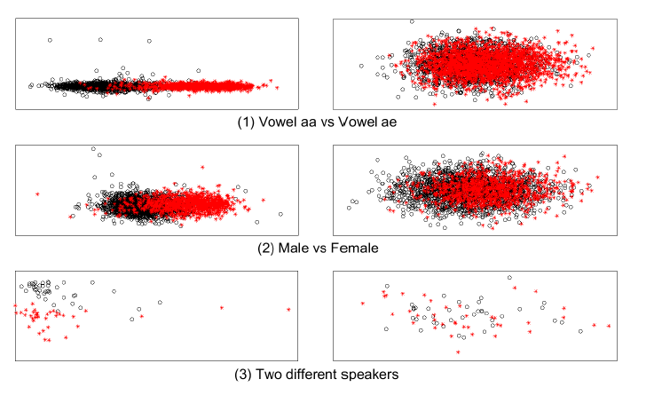
Discrimination lost

Slide 44
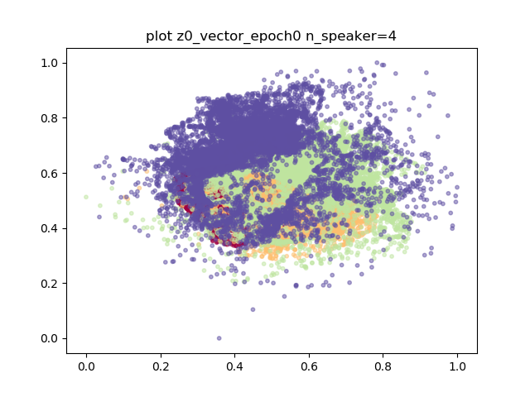
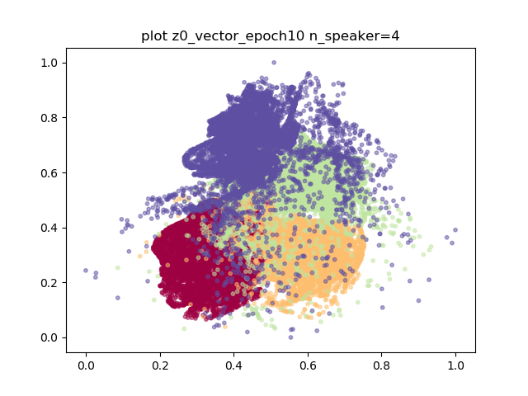
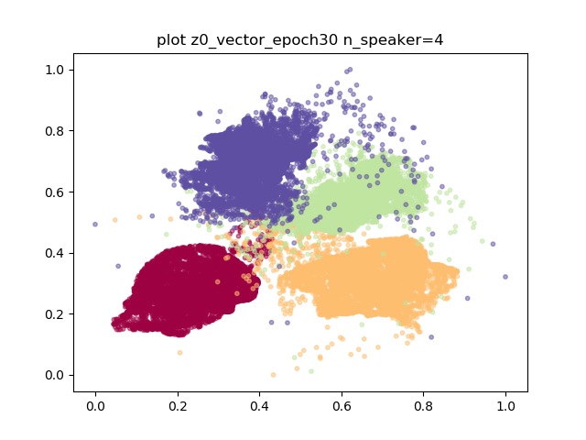
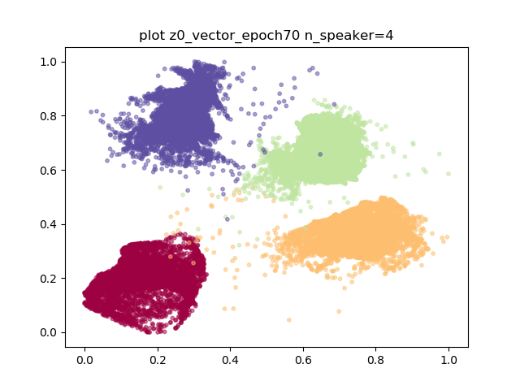
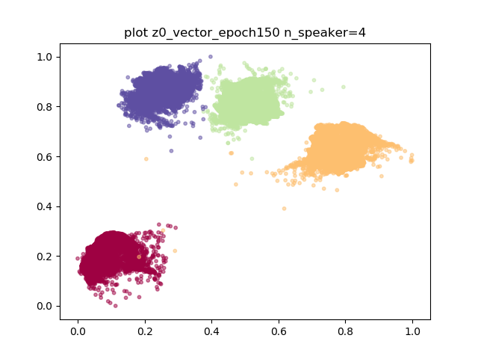
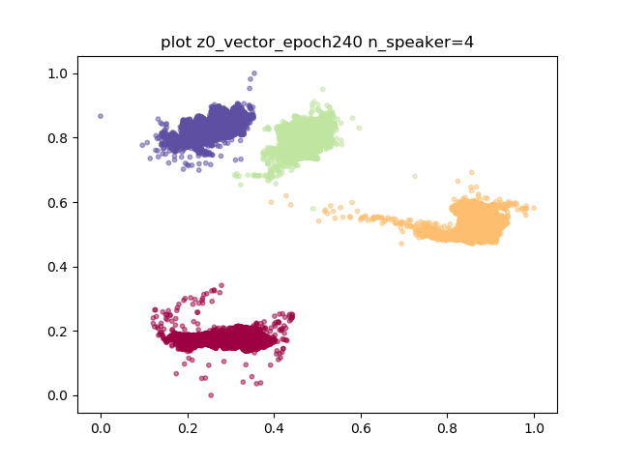
Get discrimination back
Using class information, but still maximum likelihood.

Slide 45
What the entropy-preserved flow did?
Design a generative model that simulate the generation process by complex neural net
The neural net is invertible, hence no information lost, and the inference is simple
Temporal info is preserved by looking at the whole segment
We can get a factor by moving in the z space towards a particular direction
Factorization is then done within a generative model

Slide 46
How far we are from Fujisaki model?
It has been generative.
It can be inferred.
Factors can be obained by direction, and factorization by z movement.
However hierarchical structure not identified.
Do we really need it?

Slide 47
Conclusions
We hope to factorize speech with a more comprehensive way
Fujisaki model is a good framework
We have designed two implementations for the model, one discriminative and the other generative.
Looks factorization is possible!

